Slide 1


Python Project
SIS-2129
Alpysbekov Zhandos
Saya Berik
Yerassyl Taibossunov

Slide 2

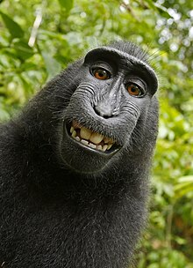

TEAM
01
02
03
Name: Alpysbekov Zhandos
Group: SIS-2129
Responsibilities in project:
Name: Saya Berik
Group: SIS-2129
Responsibilities in project:
Name: Yerassyl Taibossunov
Group: SIS-2129
Responsibilities in project:

Slide 3
University system
Welcome to the University Management System, an advanced platform designed to streamline and enhance the administrative processes within a university setting.
Our project is dedicated to providing a comprehensive solution for university administrators, faculty, and students, optimizing various tasks and fostering a more efficient and collaborative learning environment.

Slide 4
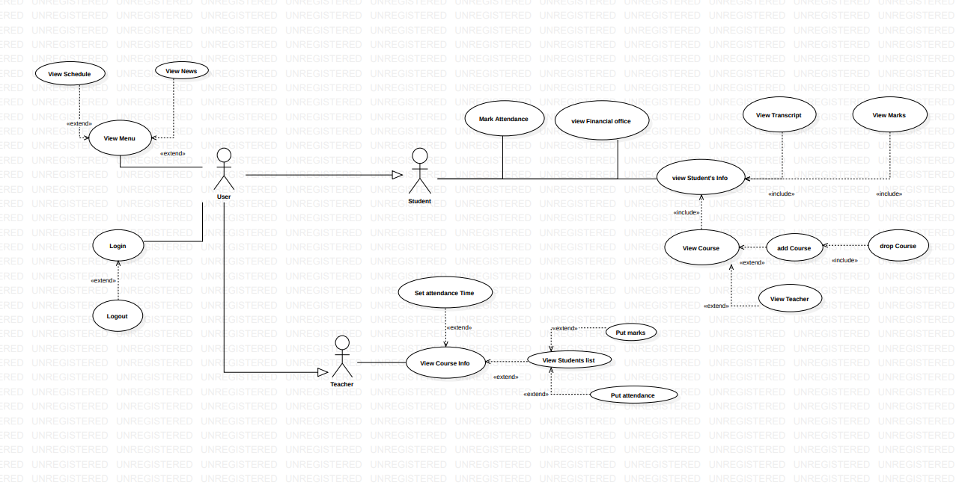
Use case diagram

Slide 5
Key Features:
User Management: Efficiently manage student and faculty profiles, including personal details, academic records, and roles.
Course and Subject Management: Easily create, modify, and manage courses and subjects. Assign teachers to subjects and track student enrollment.
Grading and Attendance: Streamline the grading process and attendance tracking for each course, ensuring accurate and timely assessment of student performance.

Slide 6
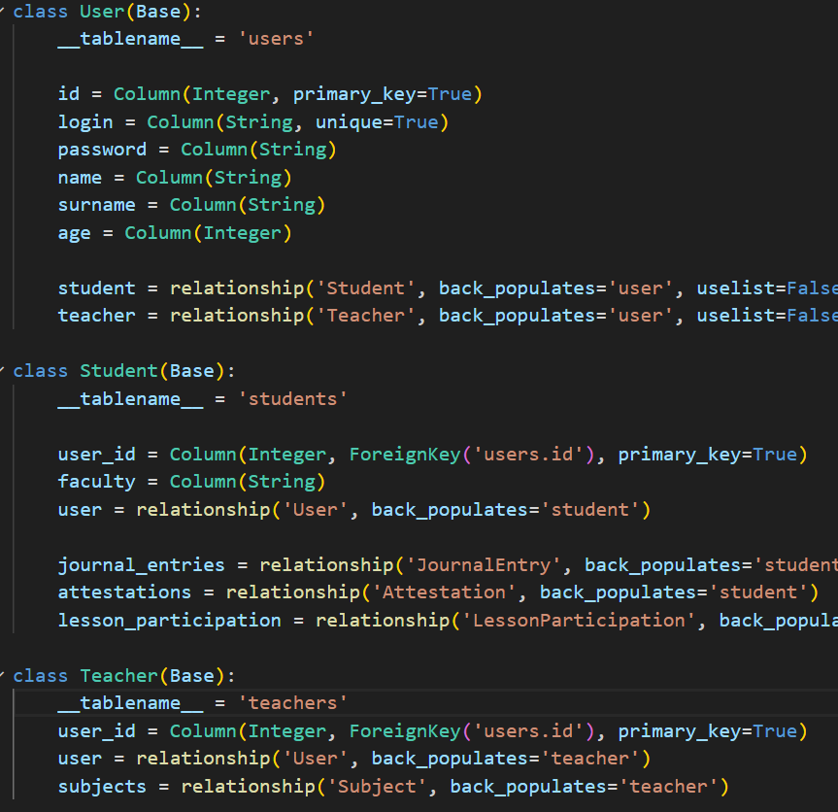
Roles
We have class Student and Teacher which inherited User class.
For creating class we use sqlalchemy which helps to connect easily with db

Slide 7
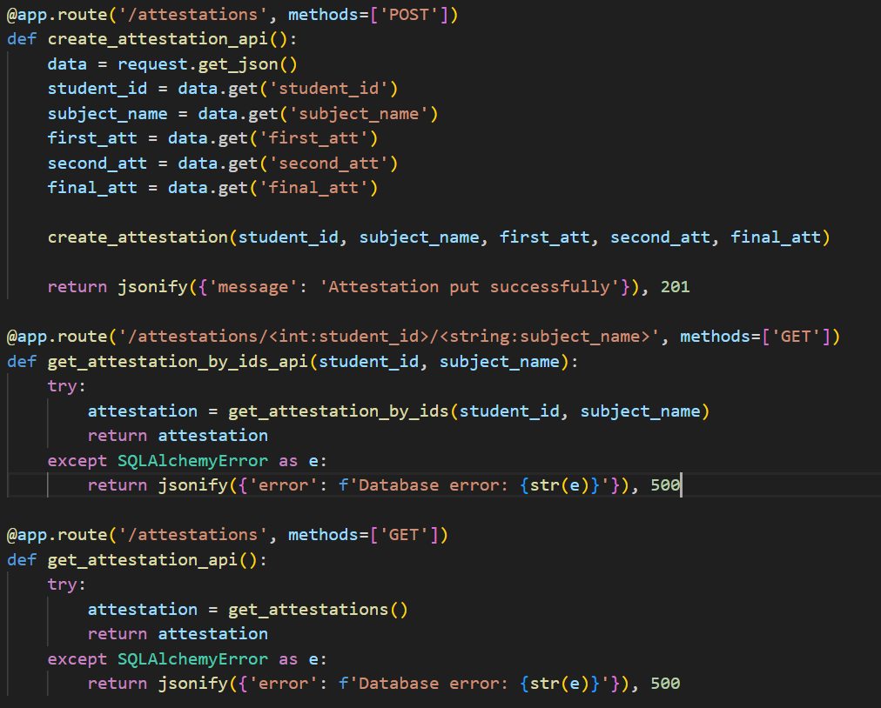
Views
In views, we created function for API using CRUD. Also we handle all errors about database and some logic errors
Example: Teacher cannot put mark to student if student haven’t any subject. Firstly student should add subject.

Slide 8
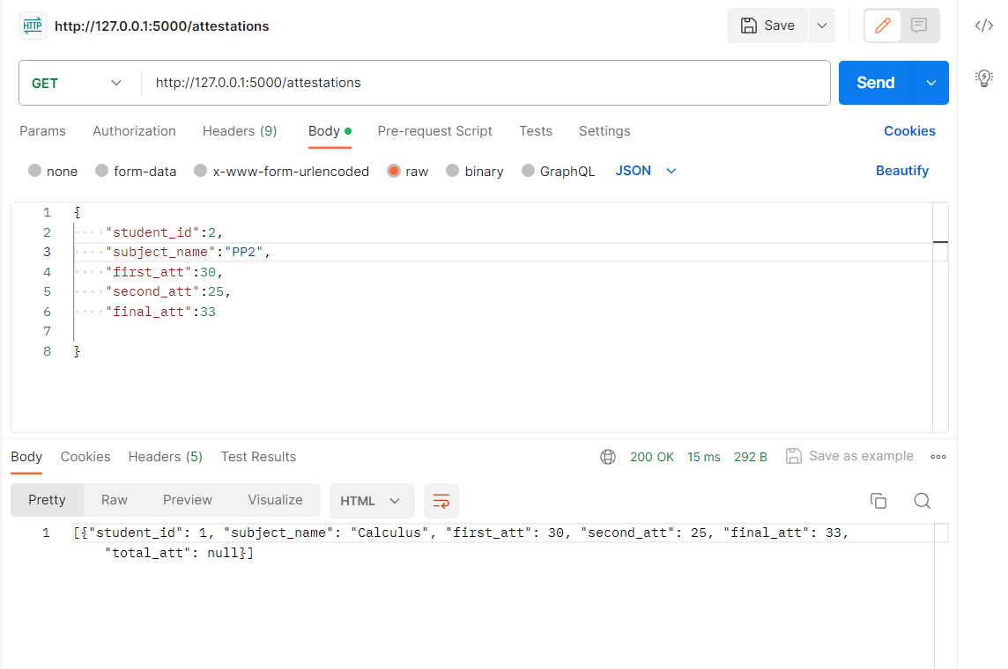
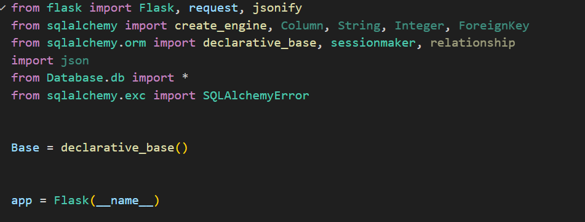
API
All api returns in json formats and we use Flask

Slide 9
Conclusion
Our group did not have enough time to implement an Admin who has access to all functions,
Did not have enough time to add a login,
Did not have enough time to add a socket.
And of course the front end.
Everything else works correctly.
It turns out that our project only works as a Back end

Slide 10


